Slide 1
Look for potential useful variables to introduce in the model:
  Droughts ... Or normalized difference vegetation index (NDVI), vegetation condition index (VCI), and temperature condition index (TCI)
  Displacements
  Livestock prices (food)
  International trading
  Population density (conflicts are always higher in capitals?)
  Socioeconomic indicators (poverty line)
  Food insecurity
  Diseases (Cholera in the horn of Africa: cholera becomes more prevalent when temperatures are high and rainfall conditions are changing. )
  Variable to describe the coping capacity of a certain region
Find websites with datasets:
  SPEI (https://spei.csic.es/database.html#p7), PDSI, NDVI (https://dataviz.vam.wfp.org/seasonal_explorer/rainfall_vegetation/visualizations), SPI
  https://www.internal-displacement.org/database/displacement-data, https://data.humdata.org/dataset?q=displacements (Horn of Africa: https://data.humdata.org/dataset?groups=eth&groups=ken&groups=som)... But data from 30/04/2016, https://dtm.iom.int/datasets
  WFP dataviz
  International trading
  Population density (conflicts are always higher in capitals?)
  Socioeconomic indicators
  https://data.humdata.org/dataset/food_security
Check whether they are significant in the regression

Slide 2
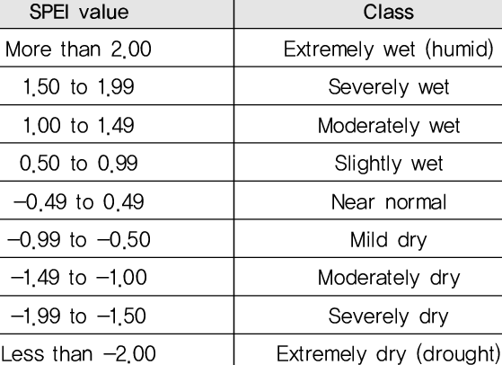
SPEI
The Standardized Precipitation Evapotranspiration Index (SPEI) is an extension of the widely used Standardized Precipitation Index (SPI).
The SPEI is designed to take into account both precipitation and potential evapotranspiration (PET) in determining drought.

Slide 3
PDSI
The Palmer Drought Severity Index (PDSI) uses readily available temperature and precipitation data to estimate relative dryness. It is a standardized index that generally spans -10 (dry) to +10 (wet).
I didn’t find gridded datasets with high resolution

Slide 4
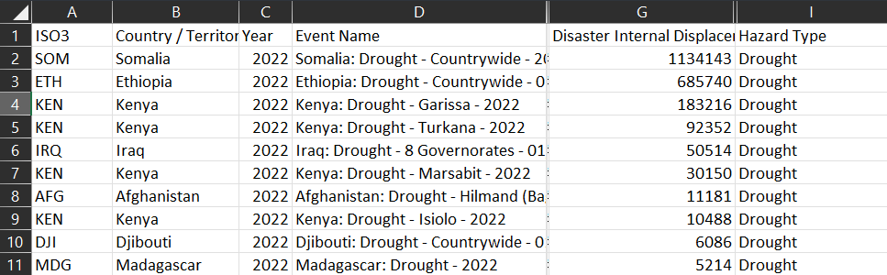

Slide 5
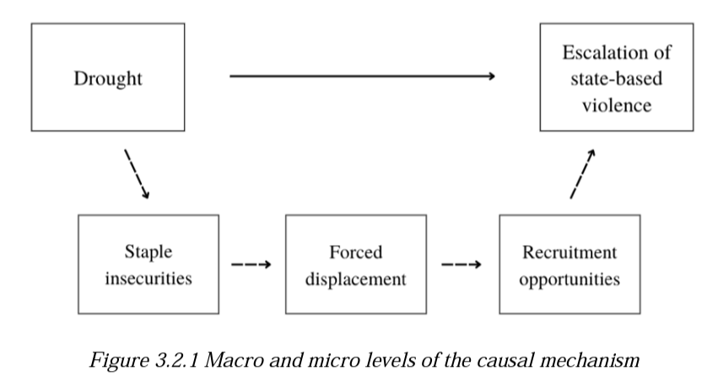
model
Build a causality and theoretical model
Use conflict as an independent variable and displacements as the dependent one?
IDV: drought flood (temp anomalies) conflicts
DV: internal displacements network

Slide 6
model
Two-Stage least squares (2SLS) regression analysis is a statistical technique that is used in the analysis of structural equations. This technique is the extension of the OLS method.
It is useful when there are feedback loops in the model.
Problem of endogenous variables, correlated with the error term

Slide 7
In our model we omit variables that are not measurable, i.e. they represent qualities that are intrinsic to the unit being measured.
In our case the unit is the country, and an example of a unit-specific variable could be the socioeconomic fabric of the country that fuels or inhibits conflicts under different environmental circumstances, or cultural aspects of decision-making of the government or the population that have evolved over hundreds of years in that country.
All these factors impact the change in conflicts, but they cannot be directly measured. While training the model on the panel data set, if we leave out such factors from the model, it will cause what is known as the omitted variable bias.
Omitted variable bias
Dummy variables in fixed effects regression

